Slide 1


Total Dissolved Gas Case STudY
UNCLASSIFIED
Zhonglong Zhang, PhD, PE, PH
Portland State University
CE-QUAL-W2 Workshop
August 16 - 18, 2022
Environmental Systems
Modeling Team
UNCLASSIFIED

Slide 2
Objectives
This case study is used to demonstrate Total Dissolved Gas (SYSTDG) modeling capabilities in W2 V4.5 model.
Bonneville Dam is located on Columbia River Mile (RM) 146.1 and is a run-of-river dam.
The reservoir is 48 miles long, from Bonneville Dam to the foot of Dalles Dam upstream, with a surface area of 29.5 square miles, and a capacity of 537,000 acre-feet.
The full forebay elevation is 77 feet, and the maximum forebay elevation is 82.5 feet.
The Dam is 171 feet high and 2,477 feet long.
The spillway is 1,070 feet long and contains 18 spill bays each with a 50 feet by 60 feet lift gate.
Bonneville Dam is equipped with 2 powerhouse units, 18 spillbays, and 1 fish ladder.
Columbia River System Operations Final Environmental Impact Statement:
https://www.nwd.usace.army.mil/CRSO/Final-EIS/
Notes:
TDG supersaturation in waters has been identified as one of the possible negative environmental effects of dams

Slide 3
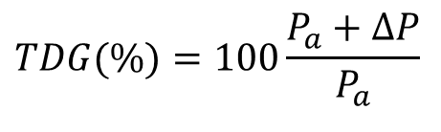
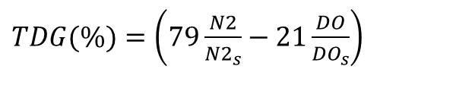
TDG Saturation
Calculating and reporting dissolved gas levels
1) Ratio of total dissolved gas pressure (TGP) to atmospheric pressure.
TDG = percent of total dissolved gas saturation (%),
P_{a} = local barometric pressure or atmospheric pressure (mmHg),
ΔP = gauge pressure (mmHg), which can be directly measured by several types of instruments.
$$TDG(\%)=100\frac{P_{a}+ΔP}{P_{a}}$$
2) Gas concentrations measured in mg/L
N2 = dissolved nitrogen gas (mg L⁻¹),
N2_{s} = nitrogen gas saturation (mg L⁻¹),
DO = dissolved oxygen [mg-O₂ L⁻¹],
DO_{s} = dissolved oxygen saturation [mg-O₂ L⁻¹].
$TDG(\%)=\left(79\frac{N2}{{N2}_{s}}−21\frac{DO}{{DO}_{s}}\right)$
Notes:
TDG is the amount of gas present in water, mainly nitrogen and oxygen.

Slide 4
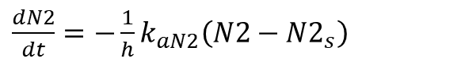
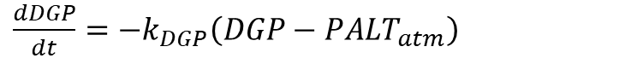
TDG Modeling in CE-QUAL-W2
TDG is computed as a derived variable
1) N2 + DO
2) DGP (Dissolved Gas Pressure)
Lake/reservoir Reaeration equations
$\frac{dN2}{dt}=−\frac{1}{h}k_{aN2}\left(N2−{N2}_{s}\right)$
k_{aN2} = nitrogen gas reaeration coefficient, m s⁻¹.
$\frac{dDGP}{dt}=−k_{DGP}\left(DGP−{PALT}_{atm}\right)$
$$k_{DGP}=max\left(k_{DGP}, MINKL\right)$$
It is assumed that wind is the dominant forcing function for reaeration.
k_{DGP}= air/water gas exchange rate, d⁻¹.

Slide 5
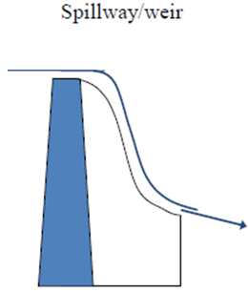
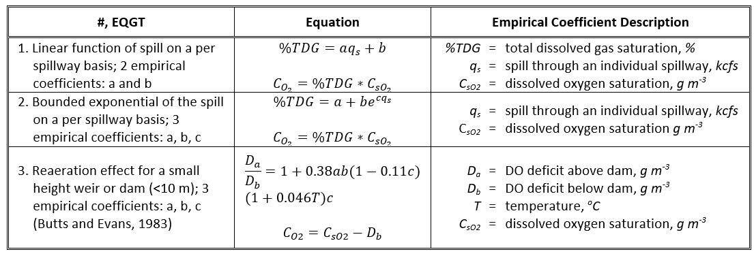
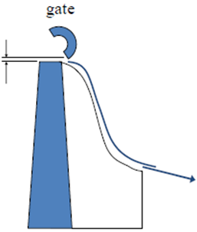
Reaeration Effects of Spillways, Weirs, and Gates

Slide 6
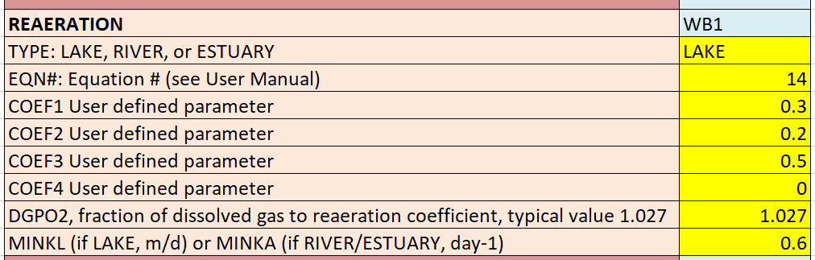
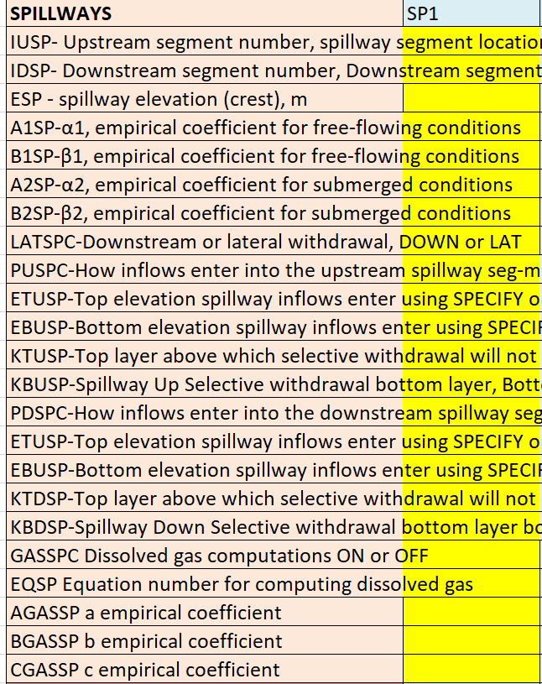
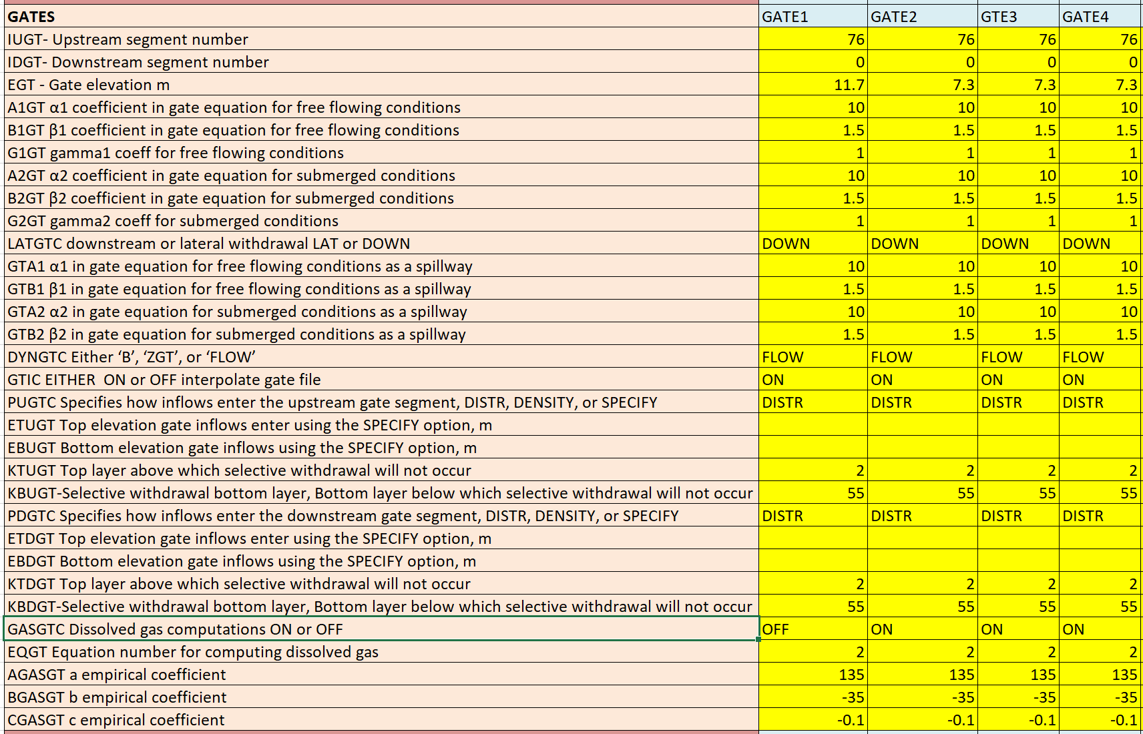
Total Dissolved Gas (TDG)

Slide 7
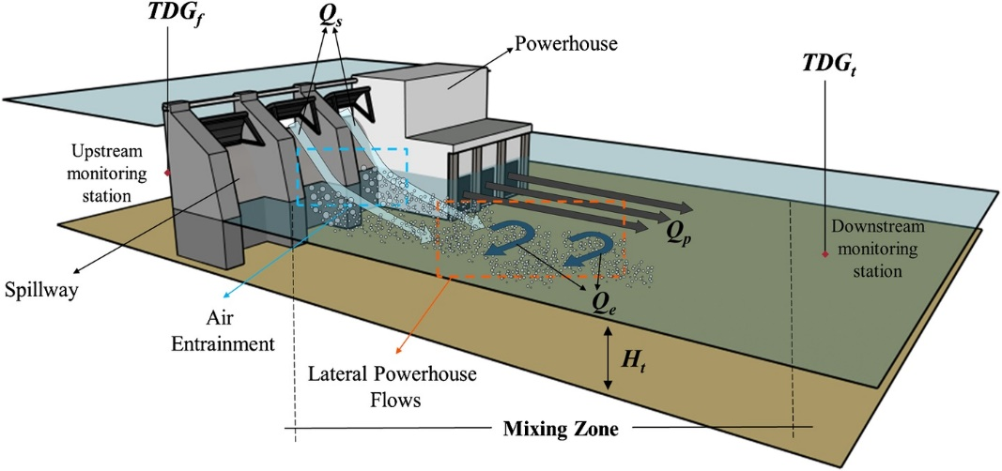
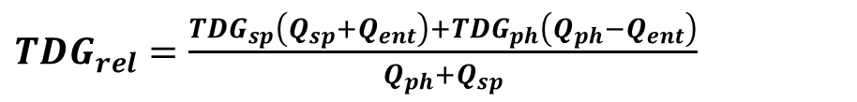
Reaeration Effects of Gates - SYSTDG Approach
${TDG}_{rel}=\frac{{TDG}_{sp}\left(Q_{sp}+Q_{ent}\right)+{TDG}_{ph}\left(Q_{ph}−Q_{ent}\right)}{Q_{ph}+Q_{sp}}$
Qtot, Qspill, Qph, Qent
TDGspill is computed from spillway TDG production equation
TDGrel is computed as the flow weighted average value
Schneider, M., Hamilton, L., 2015. SYSTDG Developer’s Manual. U.S. Army Corps of Engineers, Northwestern Division, Reservoir Control Center.

Slide 8
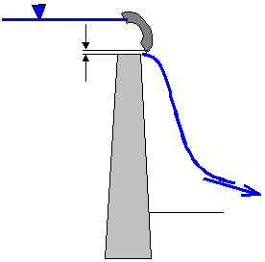
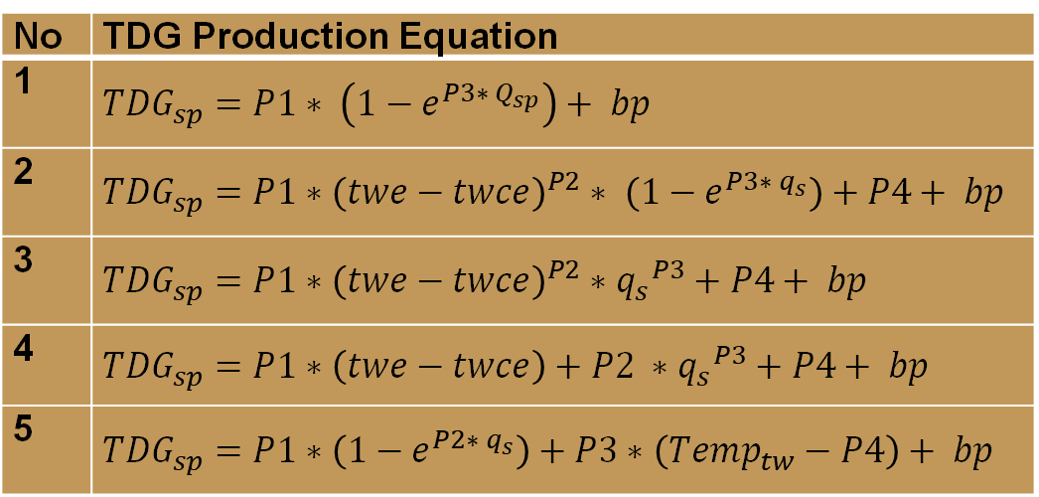
SYSTDG Algorithms
No | TDG Production Equation
1 | $${TDG}_{sp}=P1∗ \left(1−e^{P3∗ Q_{sp}}\right)+ bp$$
2 | ${TDG}_{sp}=P1∗{\left(twe−twce\right)}^{P2}∗ \left(1−e^{P3∗ q_{s}}\right)+P4+ bp$
3 | $${TDG}_{sp}=P1∗{\left(twe−twce\right)}^{P2}∗{q_{s}}^{P3}+P4+ bp$$
4 | $${TDG}_{sp}=P1∗\left(twe−twce\right)+P2 ∗{q_{s}}^{P3}+P4+ bp$$
5 | $${TDG}_{sp}=P1∗\left(1−e^{P2∗ q_{s}}\right)+P3∗\left({Temp}_{tw}−P4\right)+ bp$$
SYSTDG is an Excel-based spreadsheet model used to compute TDG saturation levels in reservoir and riverine systems.
No | Powerhouse Flow Entrainment Equation
1 | Q_{ent} = E1 * Q_{sp} + E2
2 | Q_{ent} = min[ (Q_{tot} / 60) , 1] * E1 * Q_{sp} + E2
3 | Q_{ent} = min[ (Q_{sp} / 20) , 1] * E1 * Q_{sp} + E2

Slide 9
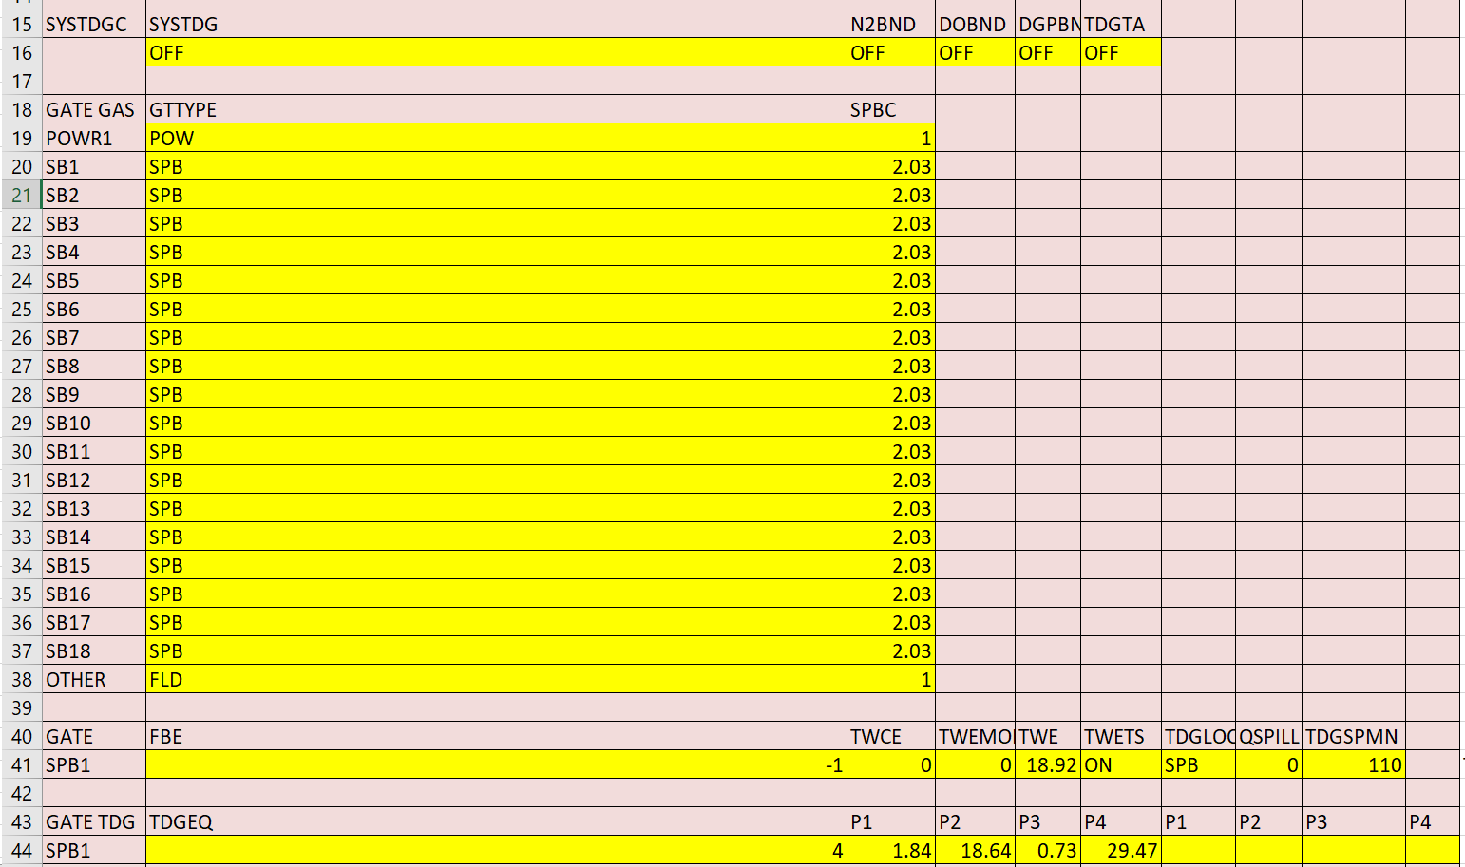
System Total Dissolved Gas (SYSTDG) Control File

Slide 10
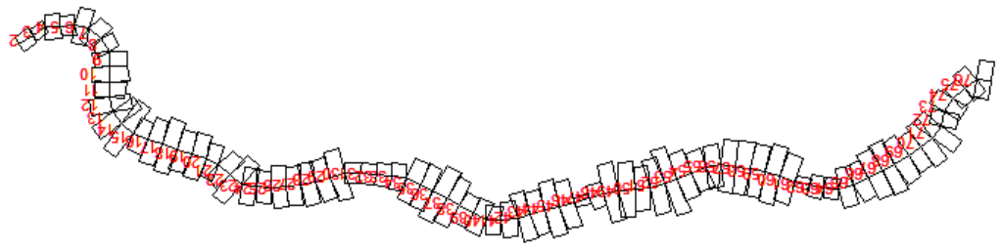
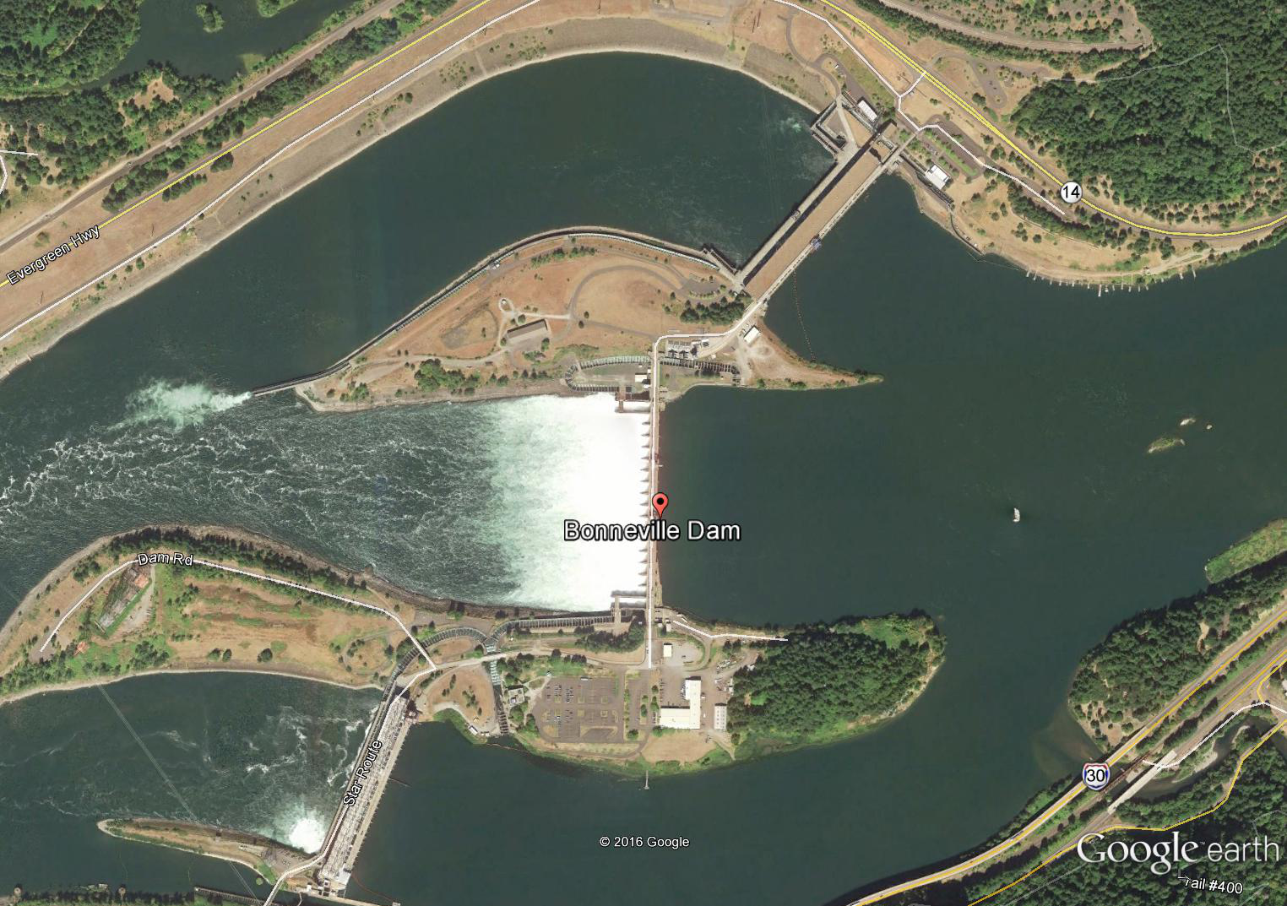
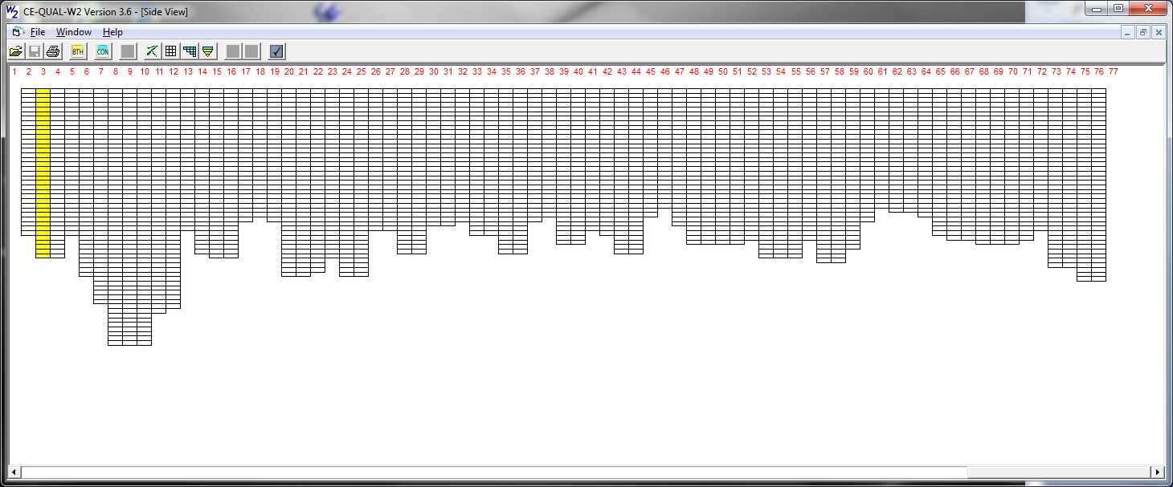
Bonneville Dam Model Demo

Slide 11
Model Inputs
w2_con.csv
w2_systdg.npt
File type |  | File name
Wind sheltering | WSC FILE WSCFN | BON_WSC.npt
Shading | SHDFN | BON_SHD_1.npt
Bathymetry | BTHFN | BON_NAVD88_BTH_2011.csv
Meteorological | METFN | BON_2011_2015_MET.csv
Branch inflow | QINFN branch inflow | DALLES_OUTFLOW.csv
 | TINFN branch temp | two_41_TDA.opt
 | CINFN branch conc | cwo_41_TDA.opt
 | QDTFN Distributed flow | BON_DistributedTribInflow.npt
 | TDTFN Distributed temp | two_41_TDA.opt
 | CDTFN Distributed conc | cwo_41_TDA.opt
Spillway/Gate | QGTFN | QGT_BON_2011_2015.csv

Slide 12
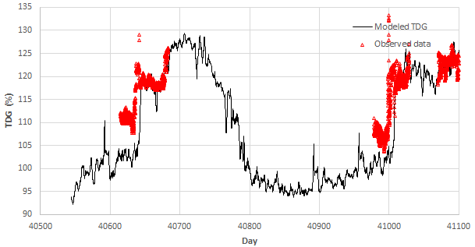
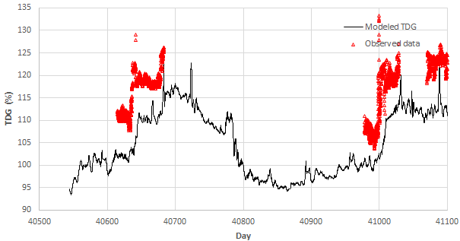
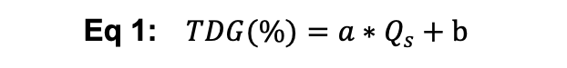
TDG Results Predicted from Two Approaches
SYSTDG = ON
SYSTDG = OFF
Eq 4:
$${TDG}_{sp}=P1∗\left(twe−twce\right)+P2 ∗{q_{s}}^{P3}+P4+ bp$$
Eq 1: $TDG(\%)=a∗Q_{s}+b$
P1 = 1.84, P2 = 18.64, P3 = 0.73, P4 = 29.47
a = 0.12, b = 105.61
Q_{ent} = E1 * Q_{sp} + E2
E1 = 0, E2 = 0

Slide 13
Hands-On Exercises

Slide 14
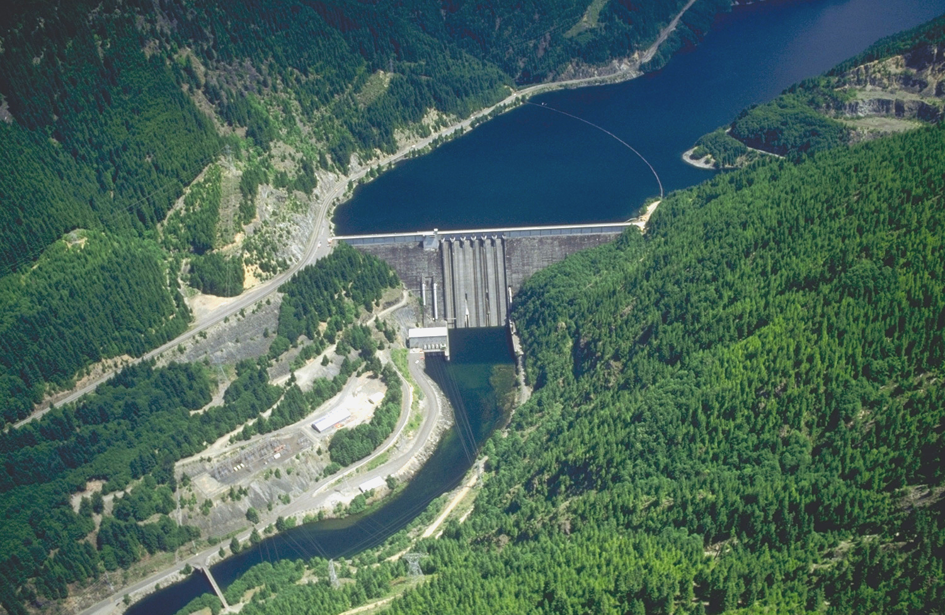
Questions?

